Slide 1
Necromancer: Enhancing System Throughput by Animating Dead Cores
Authors: Amin Ansari
Shuguang Feng*
Shantanu Gupta
Scott Mahlke
ISCA-37
June 21-23, 2010
* presenter

Slide 2
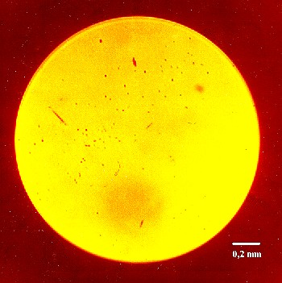
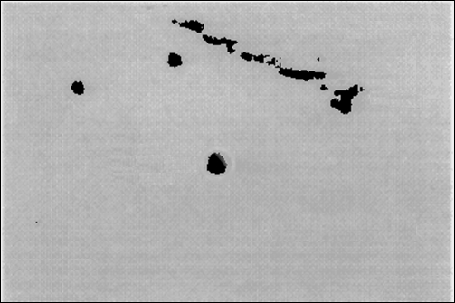
Manufacturing Defects
    Hard-faults
      Intrinsic (silicon defects)
      Extrinsic (impurities, litho imperfections)
    One defect per five 100mm²
    dies expected (ITRS)
      Threatens manufacturing yield
    Currently resolved with core disabling (e.g., IBM Cell)

Slide 3
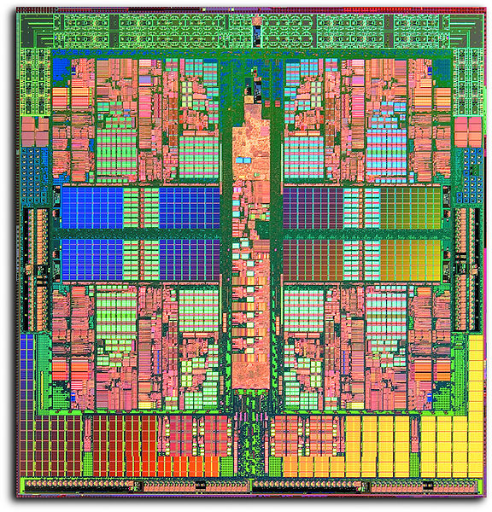
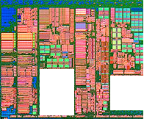
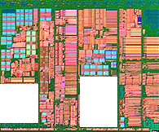




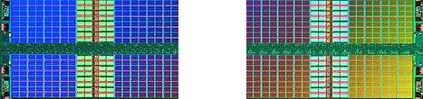
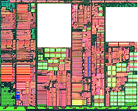
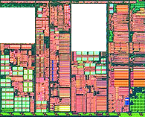







Improving Yield w/o Core Disabling
On-chip Caches
Large % of chip area
Regular design and behavior
Many existing solutions
Processing Cores
Significant % of chip area
Inherently complex and irregular
Must be addressed to improve overall yield

Slide 4

Necromancer (NM)
    Goal:
      Maintain the overall performance of a CMP in the face of hard-faults (in processing cores)
    Intuition:
      A core with a hard-fault (a “dead”
      core) may still be able to perform
      useful work
      Utilize dead cores to mitigate
      performance loss

Slide 5
Impact of Hard-Faults on Program Execution
More than 40% of the injected faults cause an immediate architectural state* mismatch (<10K instructions)
A faulty core cannot be trusted to perform correctly even for short periods of program execution
    % of injected hard-faults that manifest as architectural state* mismatches @ different latencies (# of committed instructions)

Slide 6
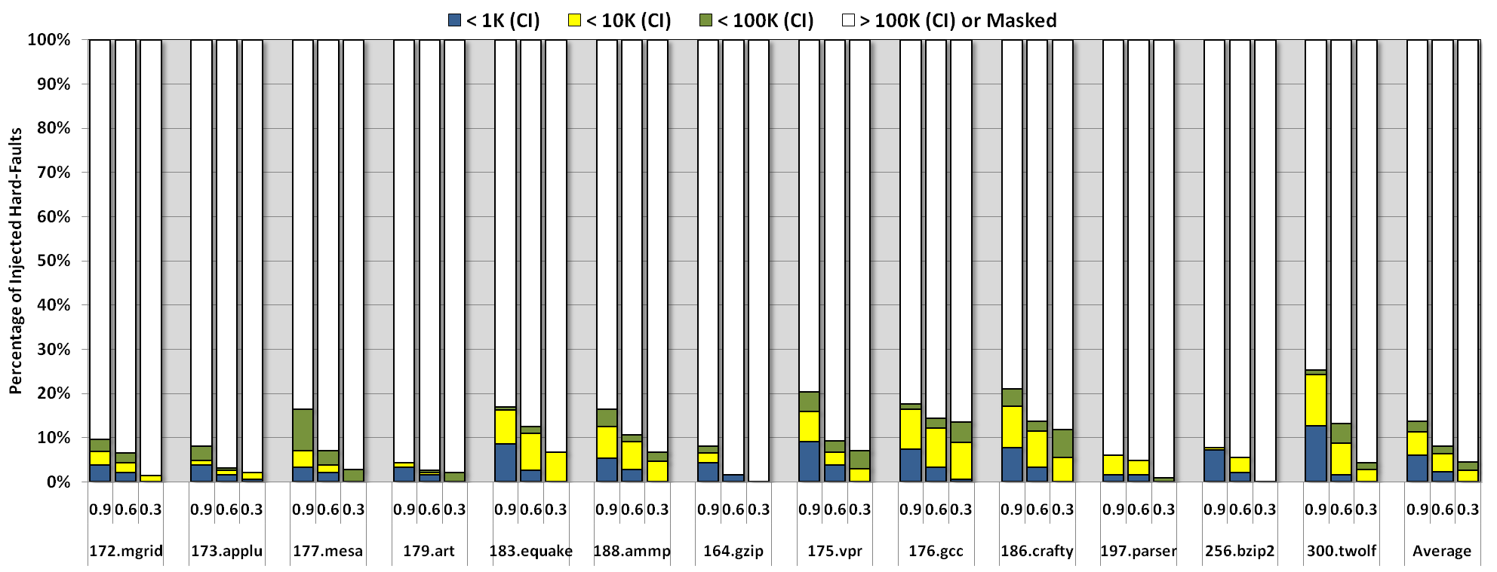
Relax Correctness Constraint
  Similarity Index: % of committed PCs matching between a faulty and golden execution (sampled @ 1K instruction intervals)
At a similarity index of 90%, more than 85% of the faulty cores can successfully commit at least 100K instructions

Slide 7
Using the (Un)dead Core to Generate Hints
Observation:
  The execution of a program on a faulty core, although imperfect, coarsely resembles a fault-free execution
(Un)dead
Core
Proposal:
  Use the faulty, “dead”, core to accelerate a fault-free core running the same application
  Extract useful information from the (un)dead core and send it as hints to the fault-free core, the “animator” core
Animator
Core
Hints
Performance

Slide 8
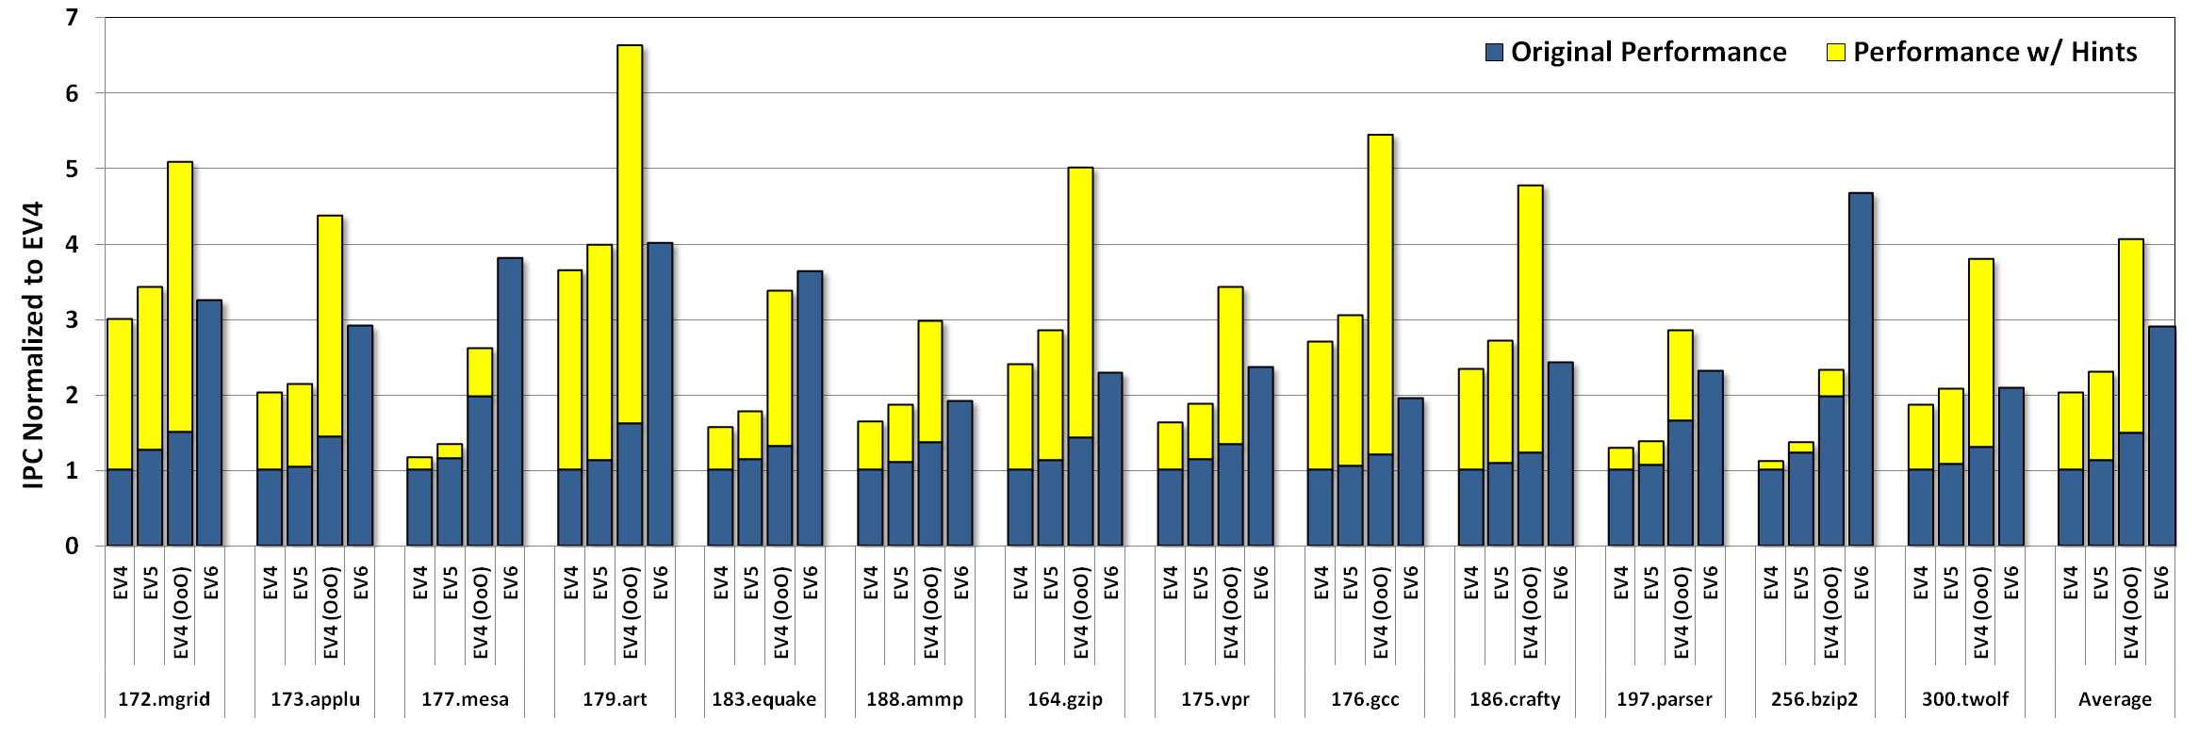
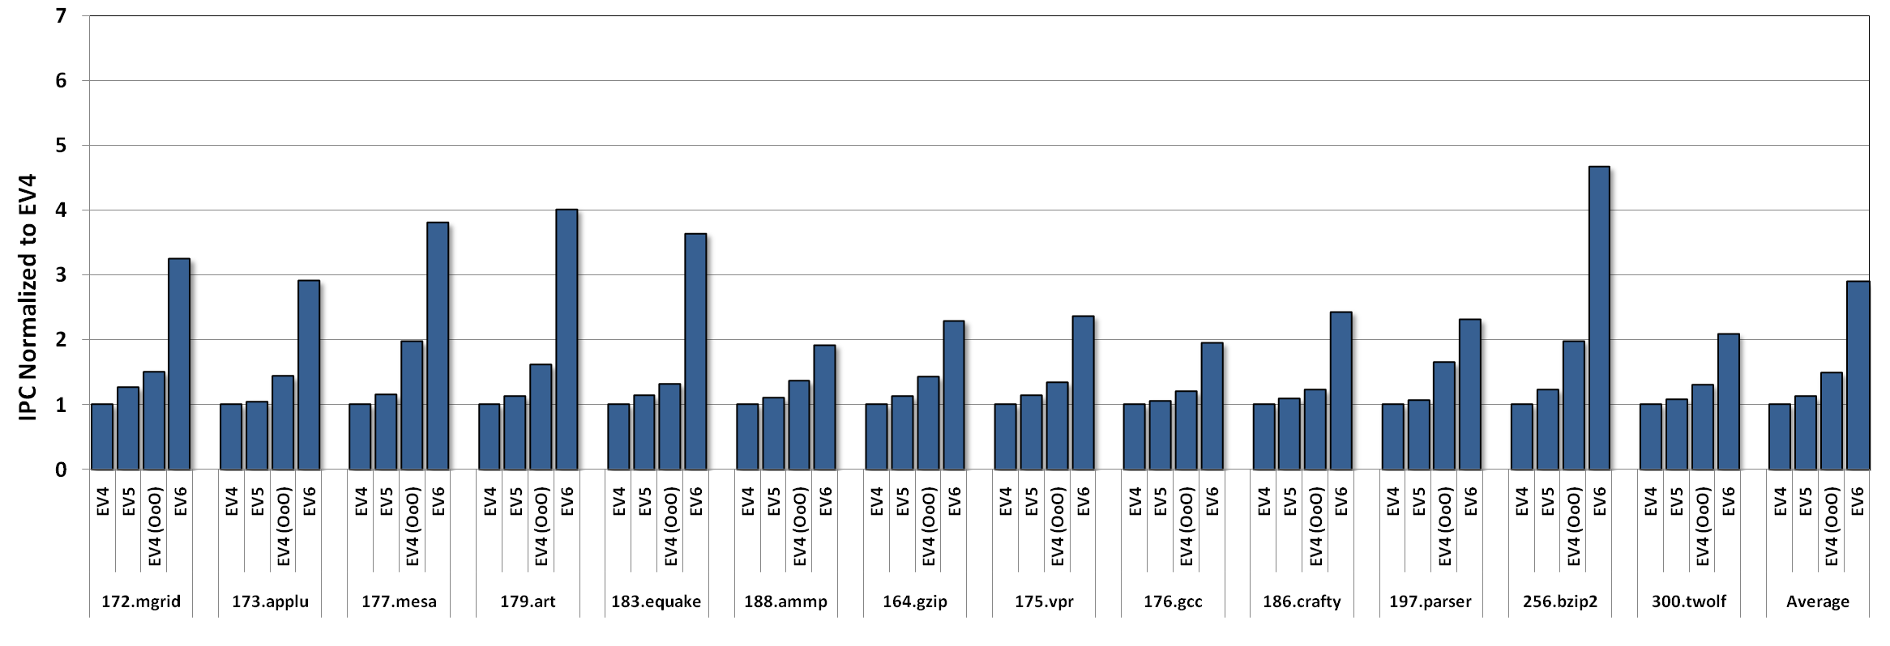
Opportunities for Acceleration
Increasing complexity/resources
  Original Performance
    IPC of different Alpha microprocessors (normalized to an EV4)
  Performance w/ Hints
    Perfect branch prediction
    No L1 cache misses
With perfect hints, most of the simpler cores (EV4, EV5, and EV4-OoO) can achieve a performance comparable to that of the 6-issue OoO EV6

Slide 9
Traditional Core Coupling
    Typically configured as leader/follower cores where the leader runs ahead and attempts to accelerates the follower
      Slipstream
      Master/slave Speculation
      Flea Flicker
      Dual-core Execution
      Paceline
      DIVA
The leader runs ahead by executing a “pruned” version of the application
Conventional coupling solutions cannot operate in the presence of frequent faults
The leader speculates on long-latency operations
The leader is aggressively frequency scaled (reduced safety margins)
A smaller follower core simplifies the design/verification of the leader core

Slide 10
(Faulty) Core Coupling Challenges
Frequent Fine-Grained Variations
  Must identify “robust” hints
  Even robust hints are not always reliable
    Necessitates fine-grained hint disabling
  The undead may execute/commit more or fewer instructions than the animator
    Difficult to determine when to apply hints
Occasional Global Divergences
  Requires periodic resynchronizations with the animator
  Online monitoring needed to identify synchronization periods

Slide 11
Necromancer Architecture
The Undead
Serves as an external run-ahead engine for the animator core
  Executes an identical copy of the program
Supplies hints to the animator
  I$: PC of committed instructions
  D$: address of committed loads
  and stores
  Branch prediction: predictor updates
Dirty D$ dirty lines are not written back
Exception generation/handling disabled
Undead Core
The Animator
An older version of the undead core with the same ISA and less resources (i.e., a previous generation)
Consumes hints to improve performance
  Prefetches on $ hints
  Branch predictor hints improves speculation accuracy
Dynamic hint disabling based on online monitoring
Provides architecturally correct state for resynchronization
Communication Queue
tail
head
Resynchronization and hint disabling
Animator Core
Inter-core Communication
Undead → Animator
  Hints sent through single unified FIFO queue
Animator → Undead
  Resynchronization data (architectural state)
  Hint disabling signals
L1-Inst
L1-Data
Memory Hierarchy
L1-Inst
L1-Data
Read-Only
Shared L2 cache
A robust heterogeneous core coupling design

Slide 12
Example: Branch Predictor Hints
Age tag ≤ # committed instructions + Δ
Type Age PC NPC
Age
Hint Format
Type Age PC NPC
Buffer
Undead Core
Cache Fingerprint
Communication Queue
PC NPC
Hint Gathering
tail
head
Hint Distribution
Hint Disabling
FET
DEC
REN
DIS
EXE
MEM
COM
Resynchronization and hint disabling
Animator Core
FET
FE
FE
DE
RE
DI
EX
ME
CO
L1-Inst
L1-Data
Memory Hierarchy
L1-Inst
L1-Data
Read-Only
Shared L2 cache

Slide 13
Example: Branch Predictor Hints
Undead Core
Tournament Predictor
Cache Fingerprint
Original AC Predictor
Communication Queue
PC
NPC
Hint Gathering
tail
head
Hint Distribution
Branch
Prediction
Hint Disabling
Resynchronization and hint disabling
Animator Core
FET
DEC
REN
DIS
EXE
MEM
COM
NM Predictor
PC
NPC
FE
FE
FE
DE
RE
DI
EX
ME
CO
PC
NPC
Undead update
L1-Inst
L1-Data
Memory Hierarchy
L1-Inst
L1-Data
Read-Only
Shared L2 cache

Slide 14
Coarse-grained Branch Prediction Disabling
Prediction Outcomes
Original BP | NM BP | Action
r | r | --
a | a | --
a | r
r | a
Undead Core
Cache Fingerprint
Communication Queue
Hint Gathering
tail
head
Hint Distribution
Hint Disabling
Hint Disabling
FET
DEC
REN
DIS
EXE
MEM
COM
Resynchronization and hint disabling
Animator Core
Counter
> Threshold Disable Hint
FE
DE
RE
DI
EX
ME
CO
L1-Inst
L1-Data
Memory Hierarchy
L1-Inst
L1-Data
Read-Only
Shared L2 cache

Slide 15
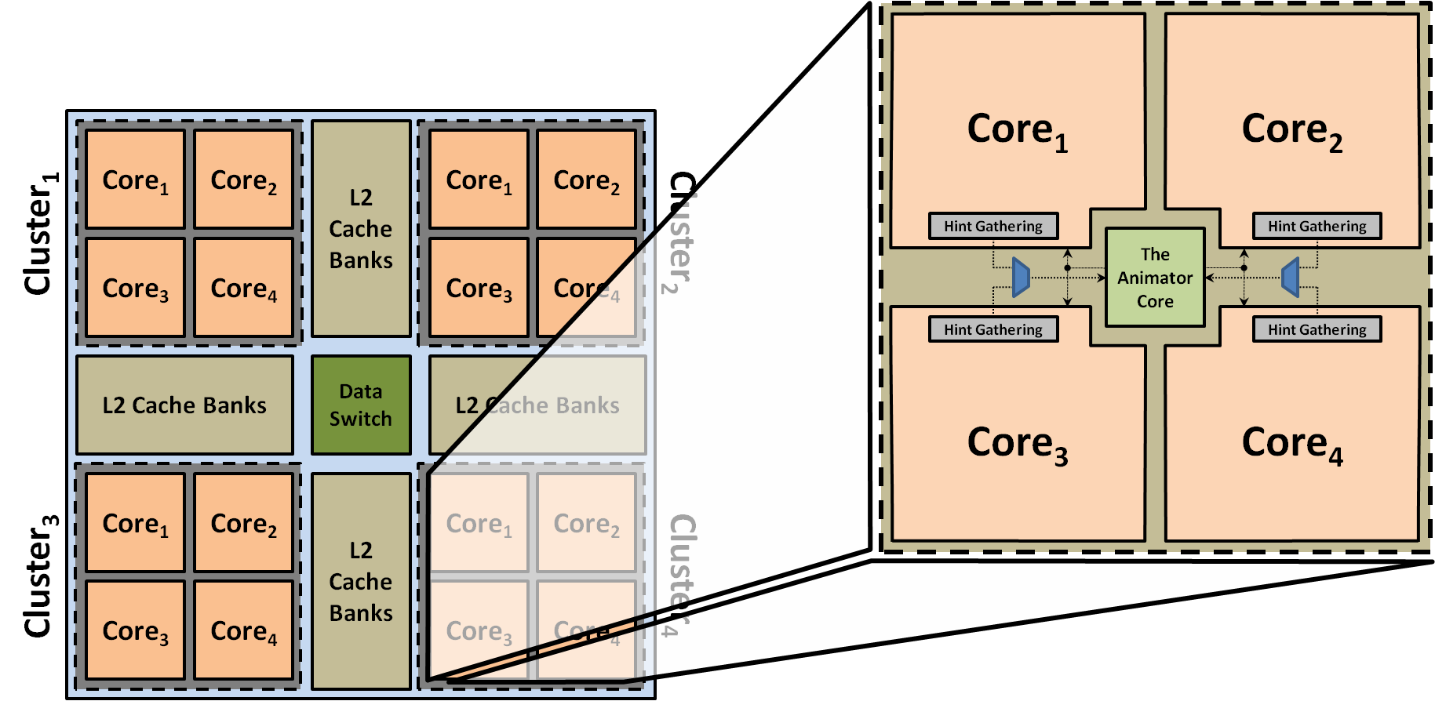
NM Design for CMP Systems

Slide 16
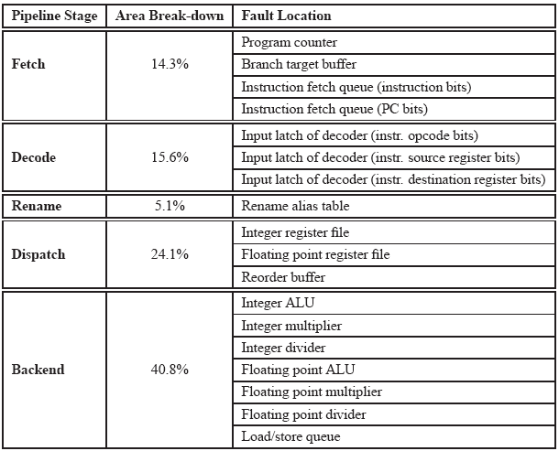
Evaluation Methodology
Area-weighted Monte Carlo fault injection (microarchitectural simulations)
  Performance
    Heavily modified SimAlpha
    SPEC-CPU-2k w/ SimPoint
  Power
    Wattch, HotLeakage, and CACTI
  Area
    Synopsys tool-chain @ 90nm
Undead Core
  Modeled after an OoO EV6
Animator Core
  Modeled after an OoO EV4
  Limited resources v. undead core
  (e.g., 8K D$ v. 64K D$)
    [Fault Injection Sites]

Slide 17
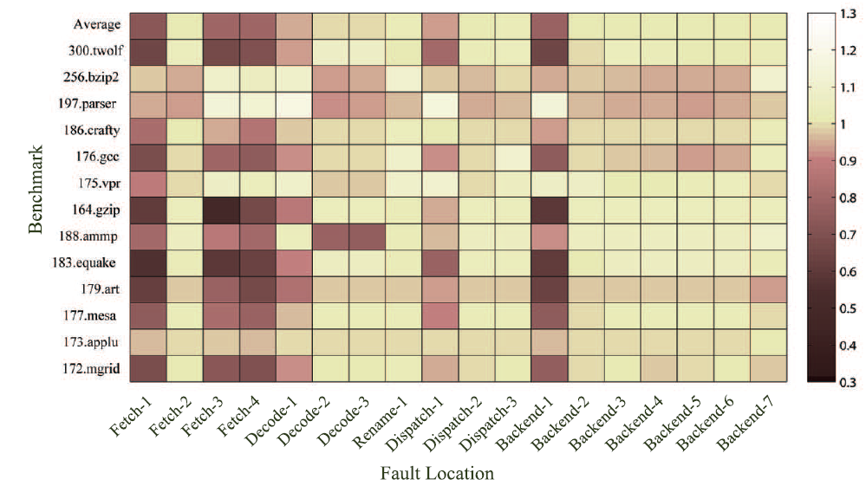
Impact of Fault Location on Performance
Program Counter
Instruction Fetch Queue
Integer ALU

Slide 18
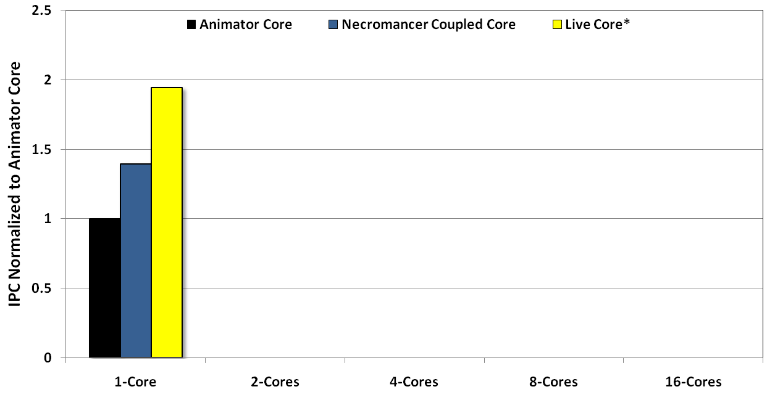
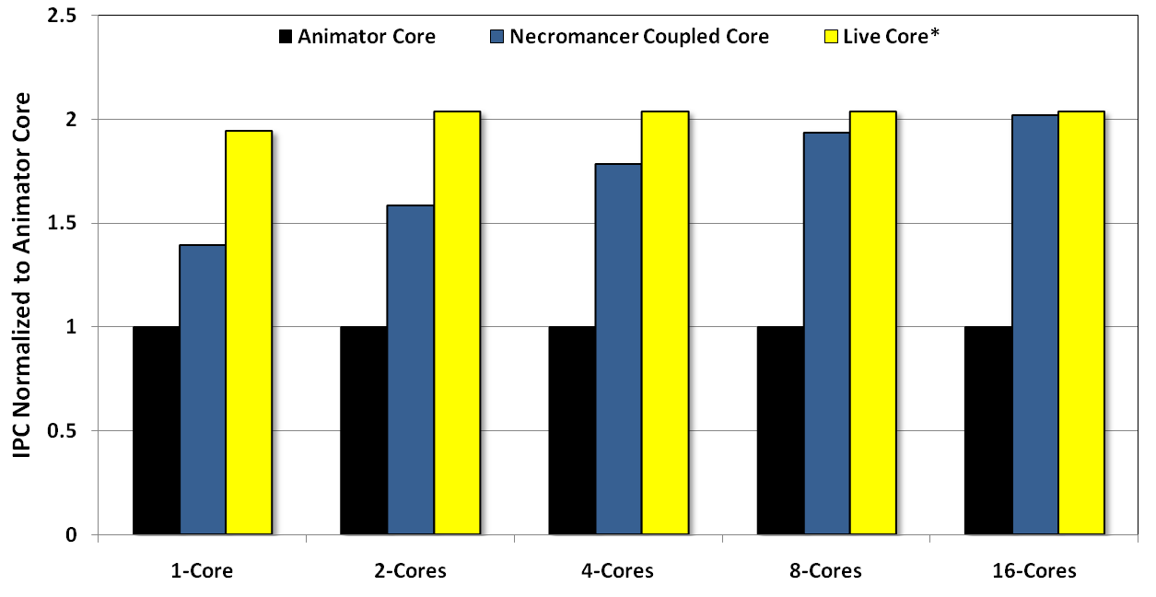
Performance Gain
    88%
    72%
    *Live core: a fault-free version of the undead core

Slide 19
Area and Power Overheads

Slide 20
Conclusion
    Faulty, “dead” cores can be revived to perform useful work
      Coupling faulty cores presents unique challenges
    Necromancer exploits efficient microarchitectural enhancements to provide
      Intrinsically robust hints (BP, I$ and D$ prefetching)
      Fine and coarse-grained hint monitoring/disabling
      Dynamic inter-core state resynchronization (see paper)
    In a 4-core CMP, Necromancer
      Recovers, on average, 88% of an undead core’s original performance
      Incurs modest area and power overheads of 5.3% and 8.5%

Slide 21

Questions?
http://cccp.eecs.umich.edu

